Slide 1
Wyższa Szkoła Przedsiębiorczośći i Administracji w Lublinie
Kierunek: Informatyka
Temat: Gospodarka w kraju wysoko rozwiniętym
Autor: Dominik Buda

Slide 2
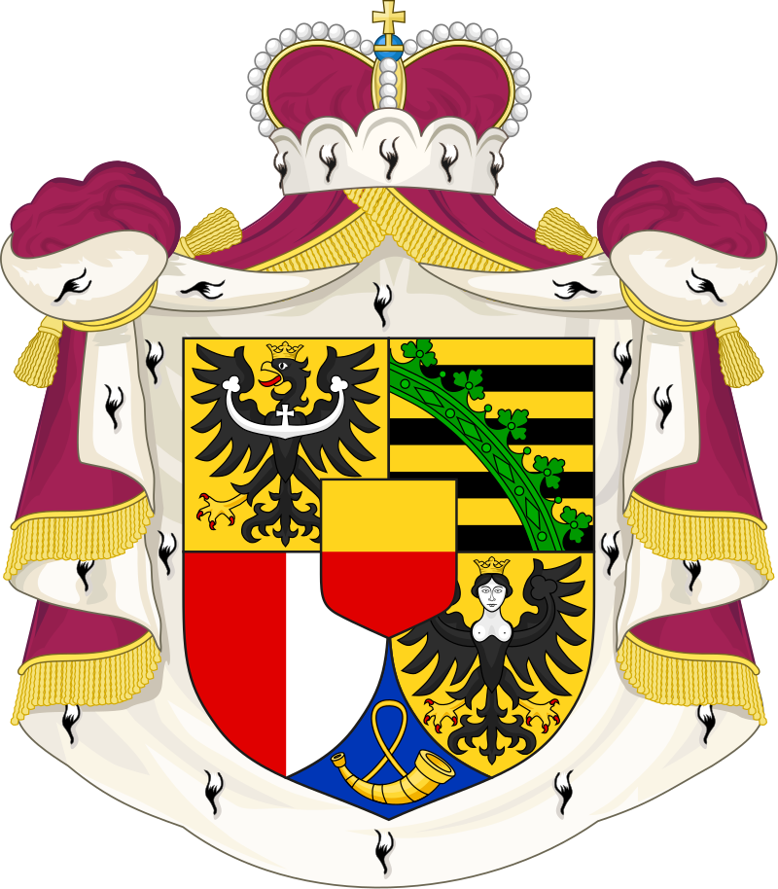
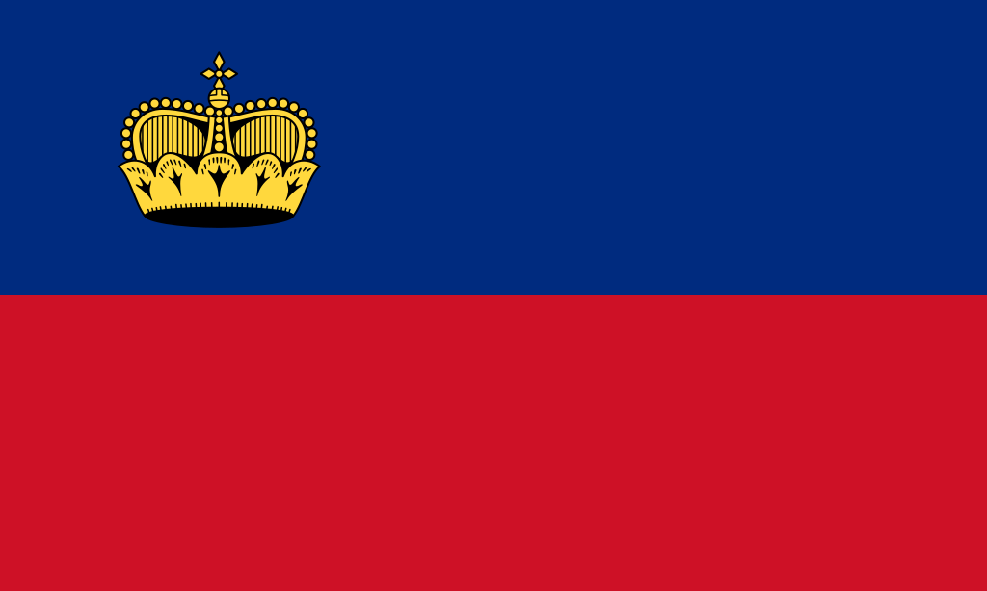
Lichtenstein

Slide 3
Basic informations:
Official language: German(Alemannic dialect)
Currency: Swiss franc(CHF)
Timezone: UTC+1(winter), UTC+2(summer)
Surface: 160,48 km²
Capital city: Vaduz
Population: 39 425

Slide 4

Economy

Slide 5

Employment structure
The number of jobs in Liechtenstein in 2018 exceeded the number of the country's inhabitants and amounted to 41,784 jobs. Most people are employed in services - 63.5%. 35.9% of the employed in industry are employed, and only 0.7% of the employed work in agriculture.

Slide 6
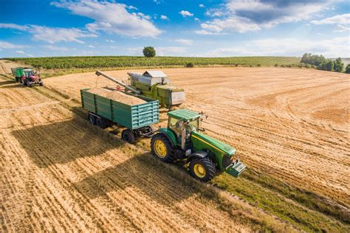
Agriculture

Slide 7
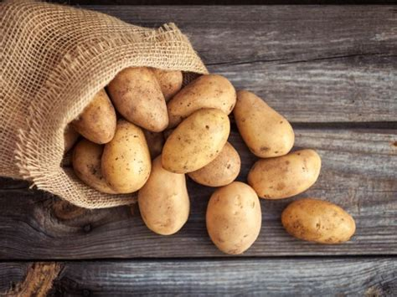
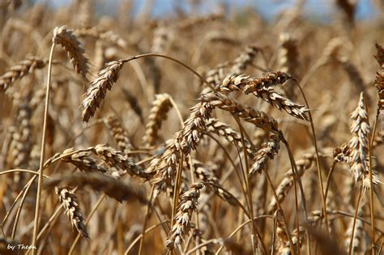
According to data from 2016, there are 102 farms in the Duchy, employing a total of 318 farmers. Agricultural land covers a total area of 3,592 ha, of which 1,355 ha are arable lands, where mainly cereals (wheat, maize and barley), but also potatoes are grown.

Slide 8
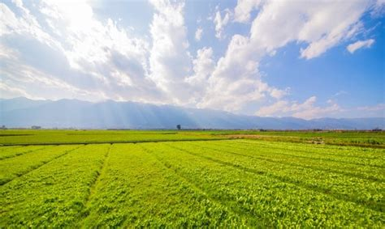
The farms in the country are of medium or small size - most of them (76.47%) have an area of less than 50 hectares. The number of farms is constantly decreasing, and from 2000 to 2016 their number decreased by 50%.

Slide 9
Animal breeding

Slide 10
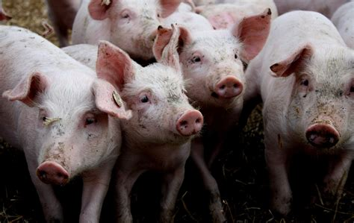
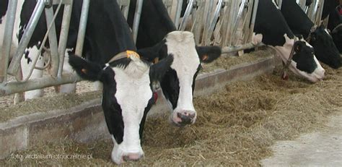
Animal husbandry is based primarily on cattle, the population of which in 2018 amounted to 5,894 heads, including 2,721 cows. Sheep (3,989 units), pigs (1,772 units) and goats (431 units) are also bred. Poultry stock was 12,916 heads, including 12,779 chickens. In addition, there are 985 bee colonies in Liechtenstein.

Slide 11
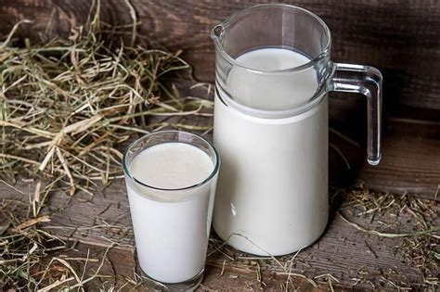
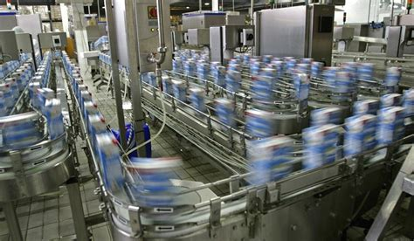
An important area of agriculture in Liechtenstein is milk processing. In 2018, 13,793.5 tons of milk were produced.

Slide 12
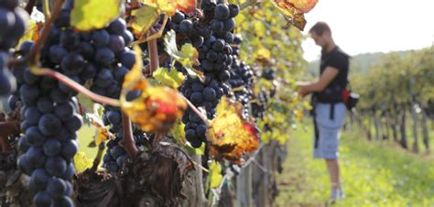
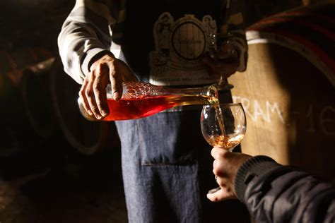
Winemaking

Slide 13
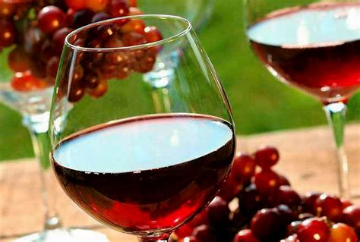
The northern and southern parts of Liechtenstein have a mild climate, which allows the cultivation of vines. There are several vineyards in Liechtenstein covering 25 hectares and about 100 winemakers. In 2018, Liechtenstein's vineyards produced 1,343 hectoliters of wine (including 883 hl of white wine). The most preferred grape varieties are Blauburgunder (Pinot noir) and Müller-Thurgau.

Slide 14
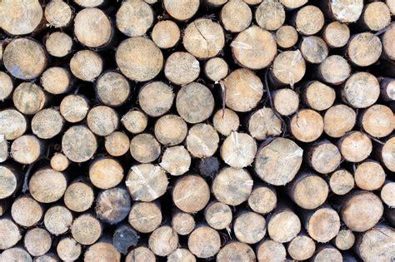
Wood

Slide 15
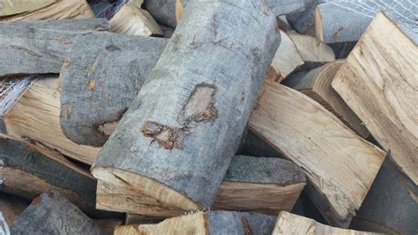
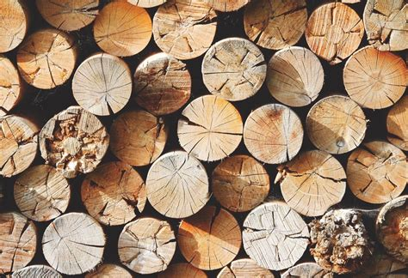
The average amount of wood produced annually in Liechtenstein (2010) is 409.5 m³ / ha, the largest percentage of which is coniferous wood - spruce (54.5%), pine (8.7%), fir (7.5%) , larch (6.3%). The wood of deciduous trees accounts for 22.7% of the total wood production (mainly beeches).

Slide 16
Thank you for watching!

